Slide 1
STAPLES.COM MARKETPLACE · CATEGORY PoC v2
Where Staples should open its marketplace
Category-level recommendations from six navigation trees – what to open to sellers, what to keep in 1P, what to fix, what to pass
Prepared for Pat · 24 September 2026 · Evidence: Staples + Office Depot, West Elm, Wayfair, Amazon, Walmart · 13,306 competitor category pages · 914 labelled checks

Slide 2
THE ANSWER
Five calls for Staples, from one decision framework
CURATE
VERTICAL EXTENSION
1P-CORE GAP
VERIFY
OFF-BRAND
Open to curated sellers now
Phase 2, via a served vertical
Keep in 1P – fix the range
Fix findability first
Pass
24 aisles · 48 sub-categories
23 aisles · 53 sub-categories
22 aisles · 30 sub-categories
121 of 219 "gaps" already sold
16 competitor depts · 57 sub-categories
Lead with Furniture › Décor (bedding, bath & shower, candles, décor, vanities); then Sewing & Tailoring, Grounds & outdoor living, home & office tables
Garden & greenhouse, outdoor structures, bedroom/dorm furniture, vases & picnic ware, fitness, material handling
Office chairs, breakroom appliances, storage, chair mats, binders, coffee. Plus 14 REVIEW aisles for merchants (lighting, tabletop)
Candles & home fragrance, evaporative coolers, pull-out pantries, sneeze guards, camera lenses – rename and cross-list
Livestock & garden supplies, craft niches, individual sports, holiday-specific décor
Source: run_framework.py → summary.json, sheet Aisle_Recommendations
Notes:
One matrix, six zones. Counts are Staples aisles (L1 › L2) and the sub-categories seen at 2+ competitors that sit under them.

Slide 3
CONTENTS
How we got to the answer
1
Competitors finalised
Who we compared against, and what each tree gives us
2
Approach and flow
Two engines (vector DB and graph DB), calibration, verification
3
Framework
Six zones on adjacency × cannibalisation; the scores
4
High-level recommendations
The matrix at Staples-aisle level; strategic themes
5
Recommendations by zone
CURATE · VERTICAL EXTENSION · REVIEW · 1P-CORE GAP · OFF-BRAND · VERIFY
6
Confidence and next steps
Stress test, method agreement, what to do next

Slide 4
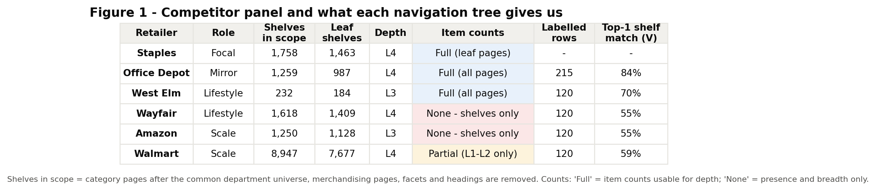
1 · COMPETITORS FINALISED
Five competitors, three lenses – and very different data
Item counts: full for Office Depot and West Elm; Walmart only at L1–L2; none for Wayfair and Amazon – so the method measures breadth (shelves) everywhere and items where both sides publish them
Depth varies from 2 to 5 levels. Embeddings use whatever path a node has, not fixed L1/L2/L3
One department universe for all six (media, apparel, grocery, toys, pets … out); merchandising pages and facets removed; menu headings kept in the tree but skipped as meaning
Mirror
Lifestyle
Scale
Office Depot
West Elm · Wayfair
Amazon · Walmart
Same B2B catalogue; shows where Staples is shallow in its own core
Design-led home and office; the 'white chair' lens
Everything stores; confirm which gaps are mainstream
Source: figures/fig01_data_availability.png · sheets Data_Audit, Scope_Audit

Slide 5
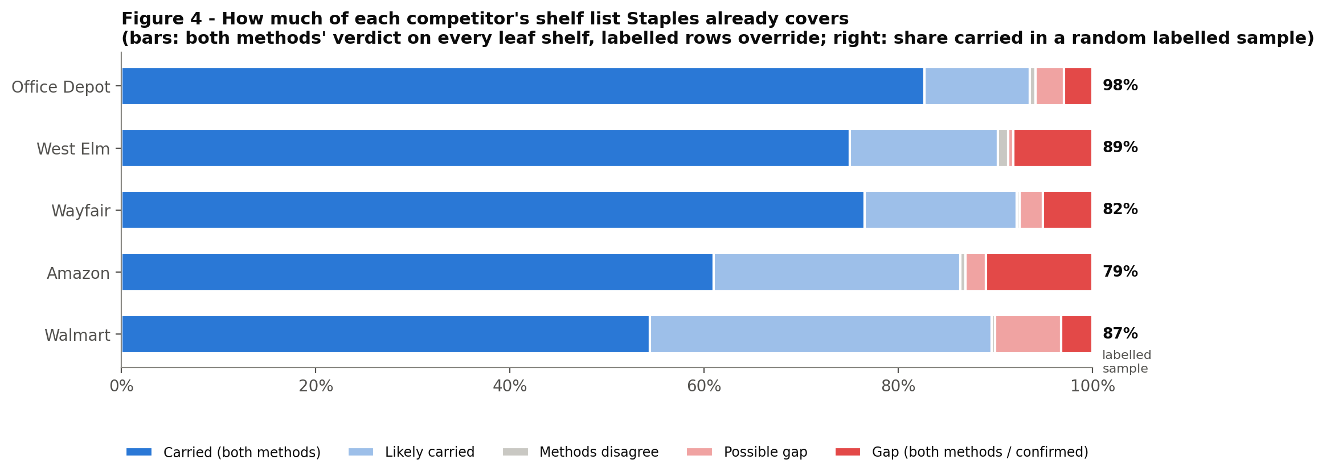
1 · COMPETITORS FINALISED
Office Depot mirrors Staples; the whitespace is with the lifestyle and scale players
A random labelled sample of each competitor's shelves: how many exist at Staples at all
Where Staples does have the shelf, it is often a token one – e.g. Bath & Shower Accessories: 8 items; Curtains, Blinds & Shades: 2
So the lifestyle story is as much DEEPEN (too thin) as ENTER (missing)
2%
11%
18%
21%
13%
of Office Depot's shelves are missing at Staples
of West Elm's shelves are missing at Staples
of Wayfair's shelves are missing at Staples
of Amazon's shelves are missing at Staples
of Walmart's shelves are missing at Staples
Source: figures/fig04_staples_coverage.png · sheets Calibration, Node_Ensemble

Slide 6
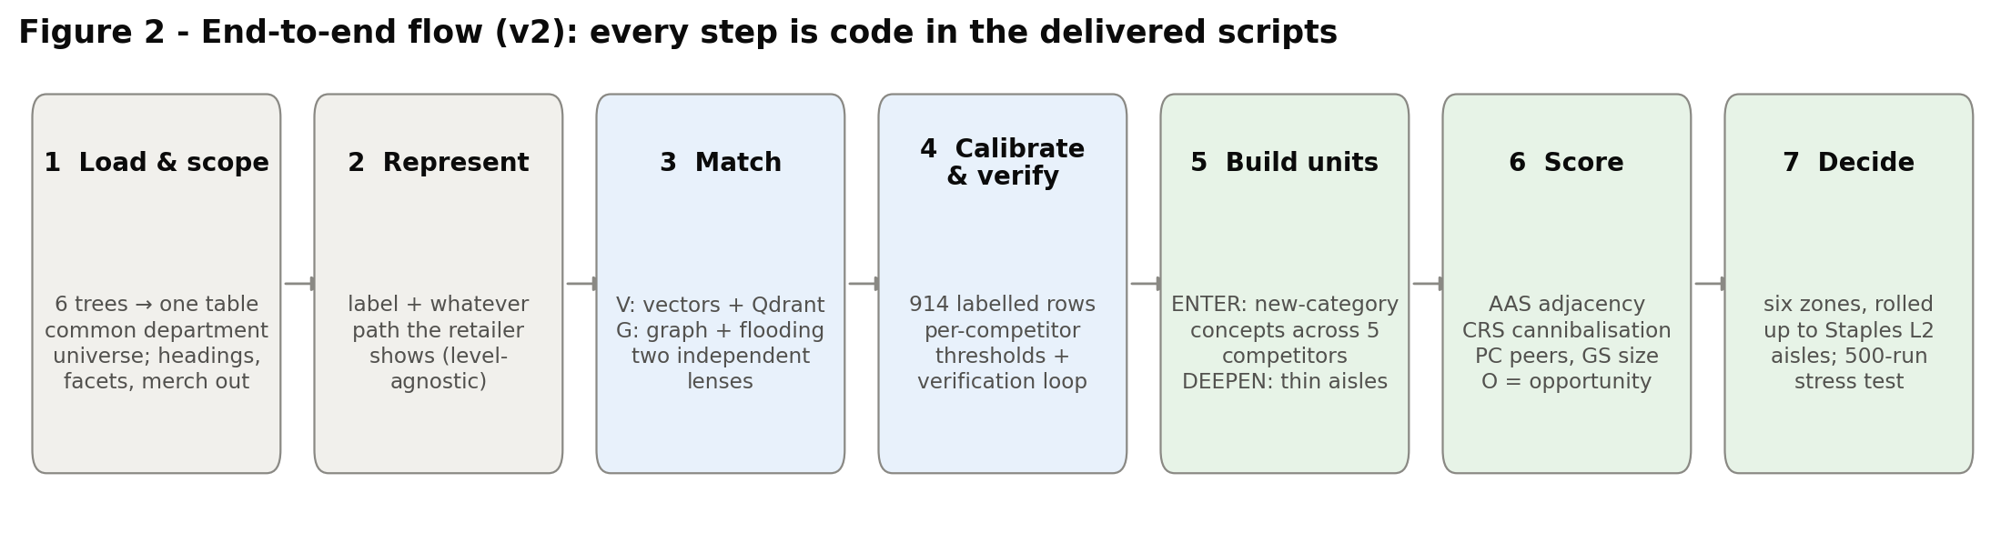
2 · APPROACH AND FLOW
Seven steps from six shelf lists to one decision matrix
Two independent engines
Calibrated, not guessed
Verified before recommended
Method V embeds every category with its path in a Qdrant vector DB. Method G builds one knowledge graph of all six trees. Scores are averaged, and disagreement lowers the evidence grade.
695 labelled rows set the 'same shelf' threshold per competitor. No hard-coded cosine; a new competitor runs on pooled calibration from day one.
219 model-flagged gaps were checked against Staples.com: 121 were already sold under another name. Those become findability actions, not assortment.
Source: figures/fig02_flow.png · code: poc_common.py, method_v_vector.py, method_g_graph.py, run_framework.py

Slide 7
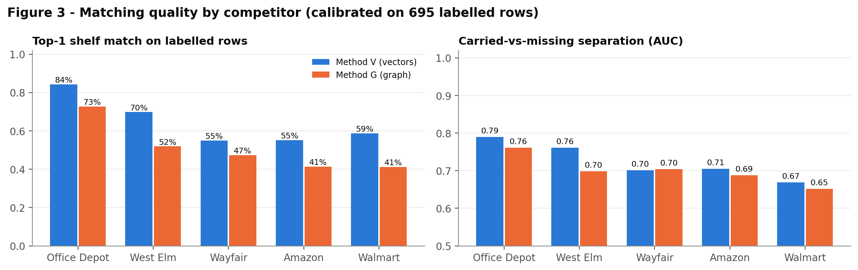
2 · APPROACH AND FLOW
Vector DB and graph DB: two lenses on the same question
Method V – vectors + Qdrant
Method G – knowledge graph
similarity: 'which Staples shelf means the same?'
structure: 'where does it sit, and what surrounds it?'
Label + ancestors, weighted by distance (level-agnostic)
Encoder chosen by bake-off: spaCy 68% top-1, WordLlama 66%, TF-IDF 60% (bge-small tested automatically in Colab)
One Qdrant collection per retailer: fast hub-and-spoke queries, and peer search ('does Wayfair have this?')
All six trees + Staples cross-listings + SAME_AS links in one graph
Similarity flooding: parents and children must match too (Office Depot top-1 61% → 73%)
Personalised PageRank from Staples' shelves = adjacency; Neo4j export
Why both? They fail differently. Vectors confuse shared words ("Drinking Glasses" vs "Drinking Fountains"); the graph is anchored by where a shelf sits. On new-category units the two place 44% in the same zone, and their adjacency scores correlate at ρ = 0.40. Where they disagree, the average places the unit and the evidence grade drops.
Source: figures/fig03_match_quality.png · outputs/V/encoder_bakeoff.csv · sheet Calibration

Slide 8
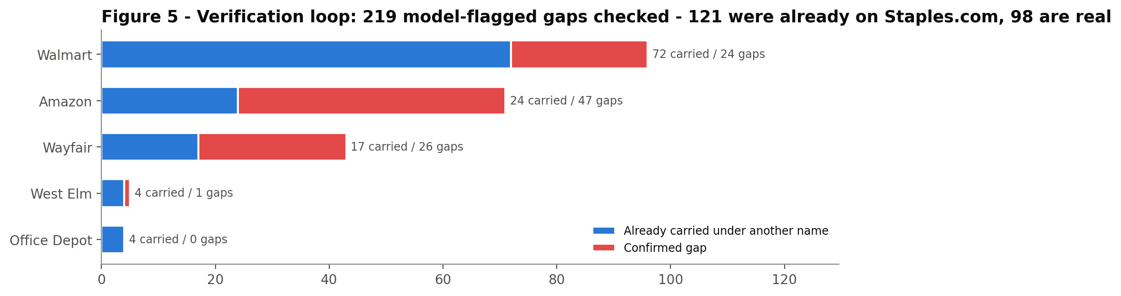
2 · APPROACH AND FLOW
Most 'missing' categories are not missing – they are hard to find
121 of 219
model-flagged gaps were already on Staples.com under another name
98
confirmed real gaps – these feed the recommendations
Patio furniture (1,116 items) lives under Gift Shop › Professional Gifts › 'Compasses'
Sneeze guards are sold as 'Desktop Privacy Panels'
Checks are stored as labels: they override both models on every re-run and become the VERIFY findability list
Source: figures/fig05_verification_loop.png · sheet Verification_Log

Slide 9
3 · FRAMEWORK
Two questions place every category in one of six zones
CURATE
VERTICAL EXTENSION
OFF-BRAND
The scores
AAS – adjacency (0–100): how embedded in what Staples sells; 100 = a typical Staples shelf
CRS – cannibalisation risk (0–100): closeness to a Staples shelf × how core that shelf is to 1P
PC – how many of 5 competitors show it · GS – how big the missing chunk is
O = (0.35 PC + 0.35 GS + 0.30 AAS/100) × (1 − CRS/100)
Grade A = 3+ competitors and both engines agree
CRS < 40 · AAS ≥ 60
CRS < 40 · AAS 40–60
CRS < 40 · AAS < 40
Open to curated sellers now
Phase 2 through a served vertical
Pass – real gap, wrong store
REVIEW
1P-CORE GAP
VERIFY
CRS 40–60
CRS ≥ 60
Flagged, may already exist
Merchant decision
Fix in 1P; keep out of marketplace
Check first; fix findability
Source: poc_common.label_row, opportunity · run_framework.label_and_rank

Slide 10
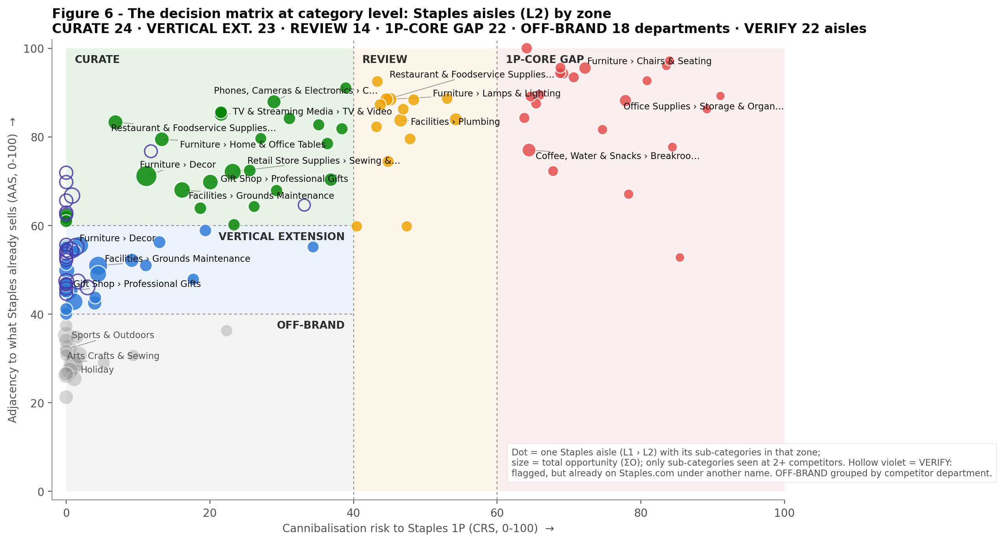
4 · HIGH-LEVEL RECOMMENDATIONS
The decision matrix: Staples aisles by zone
CURATE
24 aisles · 48 sub-categories
VERTICAL EXTENSION
23 aisles · 53 sub-categories
REVIEW
14 aisles · 18 sub-categories
1P-CORE GAP
22 aisles · 30 sub-categories
OFF-BRAND
16 depts + 2 aisles · 57 sub-categories
VERIFY
22 aisles · 31 sub-categories
Source: figures/fig06_matrix_aisles.png · sheet Aisle_Recommendations (dot = Staples L1 › L2 aisle; size = ΣO)

Slide 11
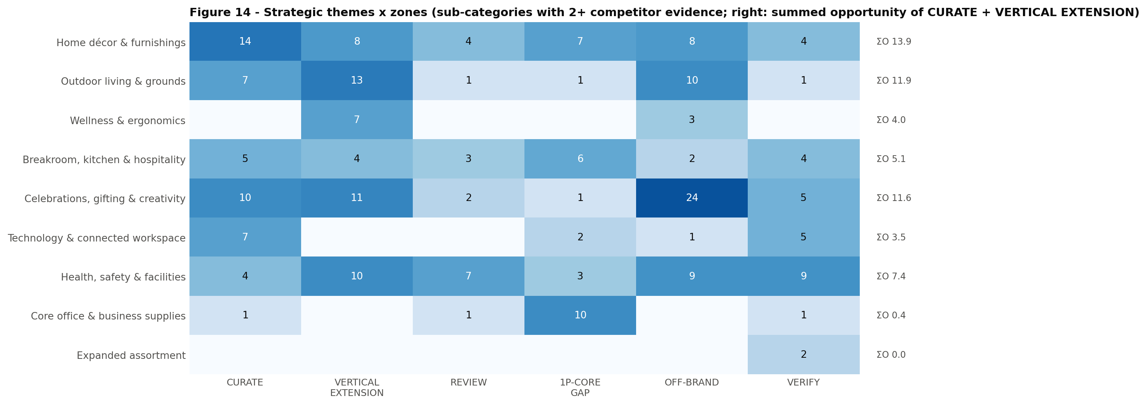
4 · HIGH-LEVEL RECOMMENDATIONS
L1 view: home décor, creativity and outdoor living lead; the core stays 1P
Home décor & furnishings leads: 14 CURATE sub-categories, ΣO 13.9 – the 'white chair' logic
Celebrations, gifting & creativity: ΣO 11.6 – sewing, quilting, party décor
Outdoor living & grounds: ΣO 11.9 – planters, patio, garden, outdoor structures
Core office & business supplies: 10 of 13 sub-categories are 1P-CORE GAP
Source: figures/fig14_themes.png · sheet Themes

Slide 12
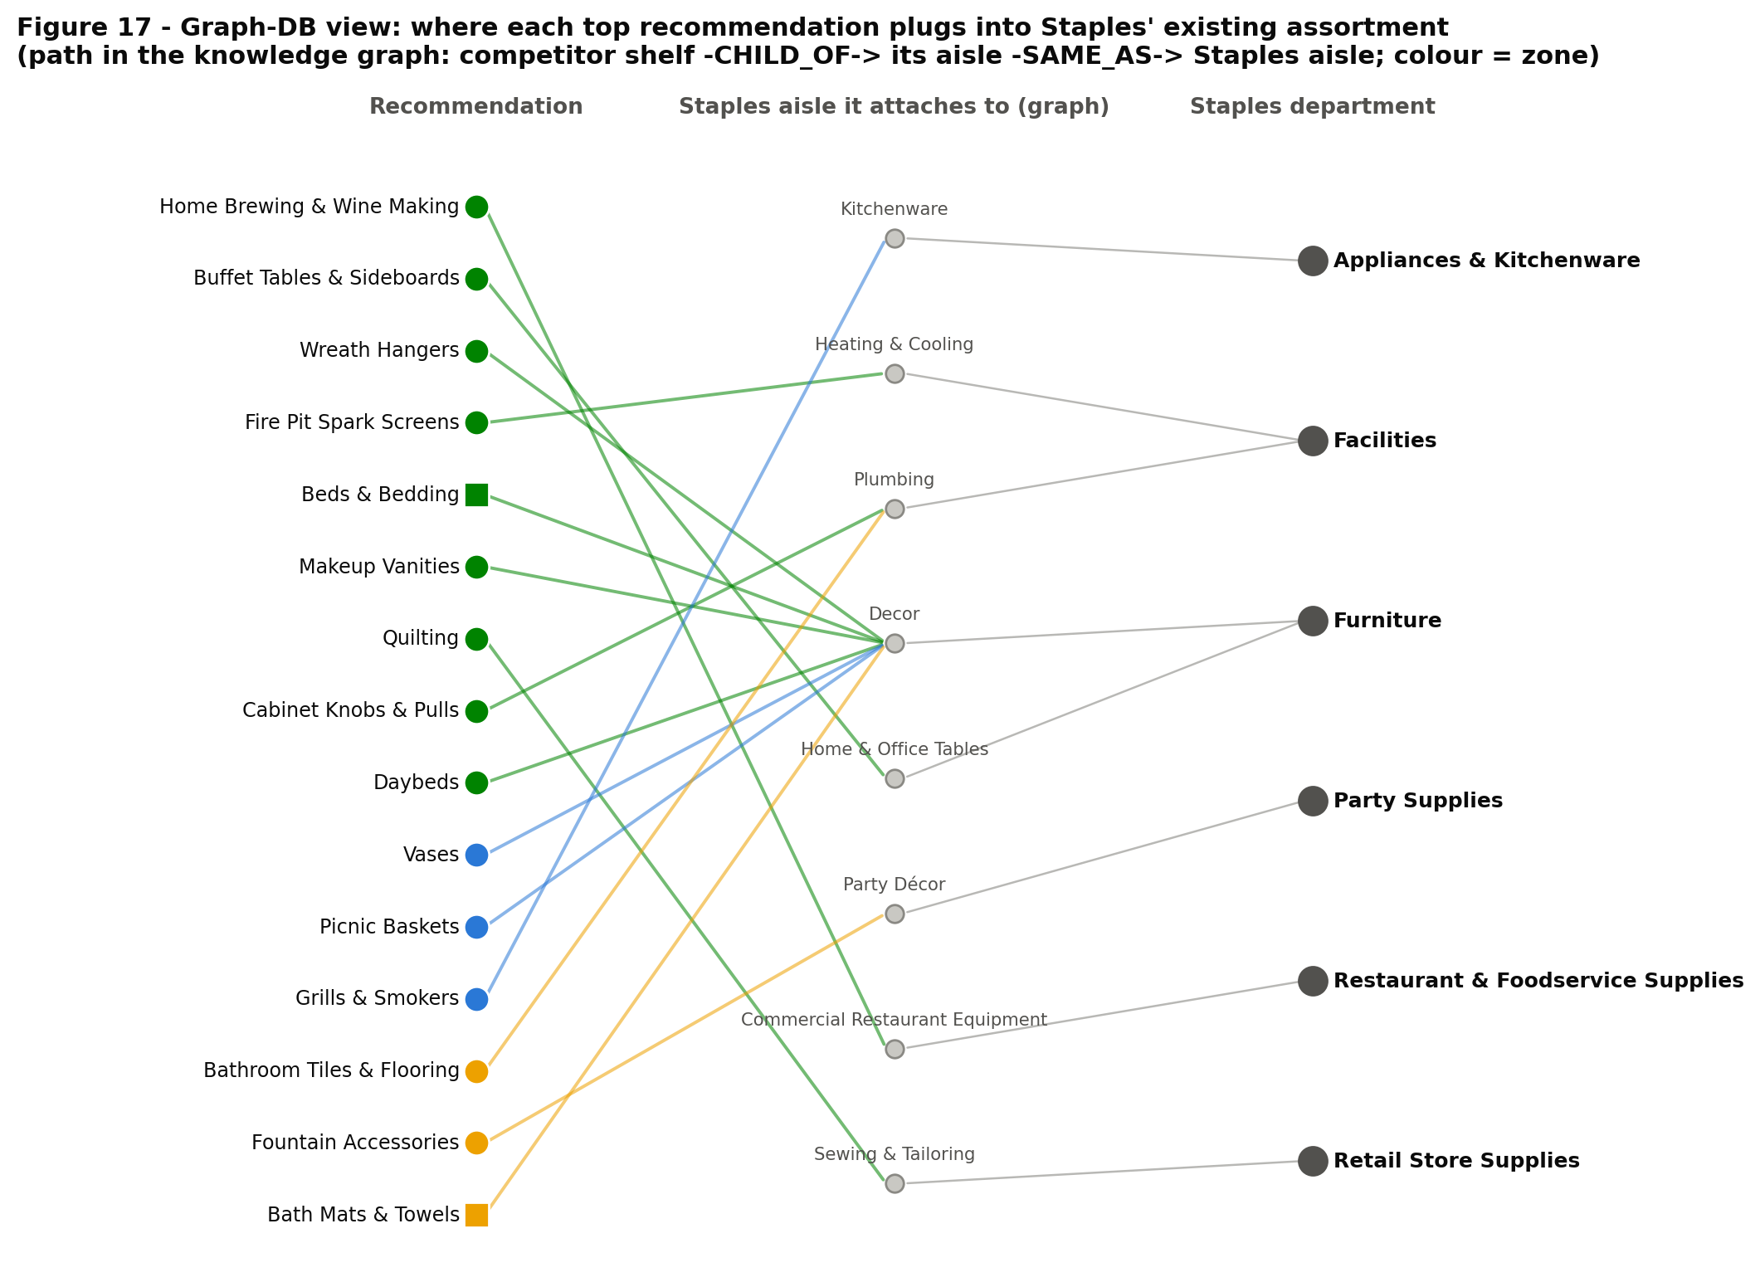
4 · HIGH-LEVEL RECOMMENDATIONS
Graph-DB view: where each recommendation plugs into Staples' aisles
Path in the knowledge graph: competitor shelf → its aisle (CHILD_OF) → the Staples aisle it matches (SAME_AS) → Staples department
The largest group of CURATE picks docks into Furniture › Décor – one aisle to open first, not a scatter of categories
The same graph is exported to Neo4j with ready-made queries (consensus whitespace, aisle whitespace, cannibalisation)
Source: method_g_graph.py + run_framework.py → figures/fig17_graph_dock.png · outputs/G/neo4j

Slide 13
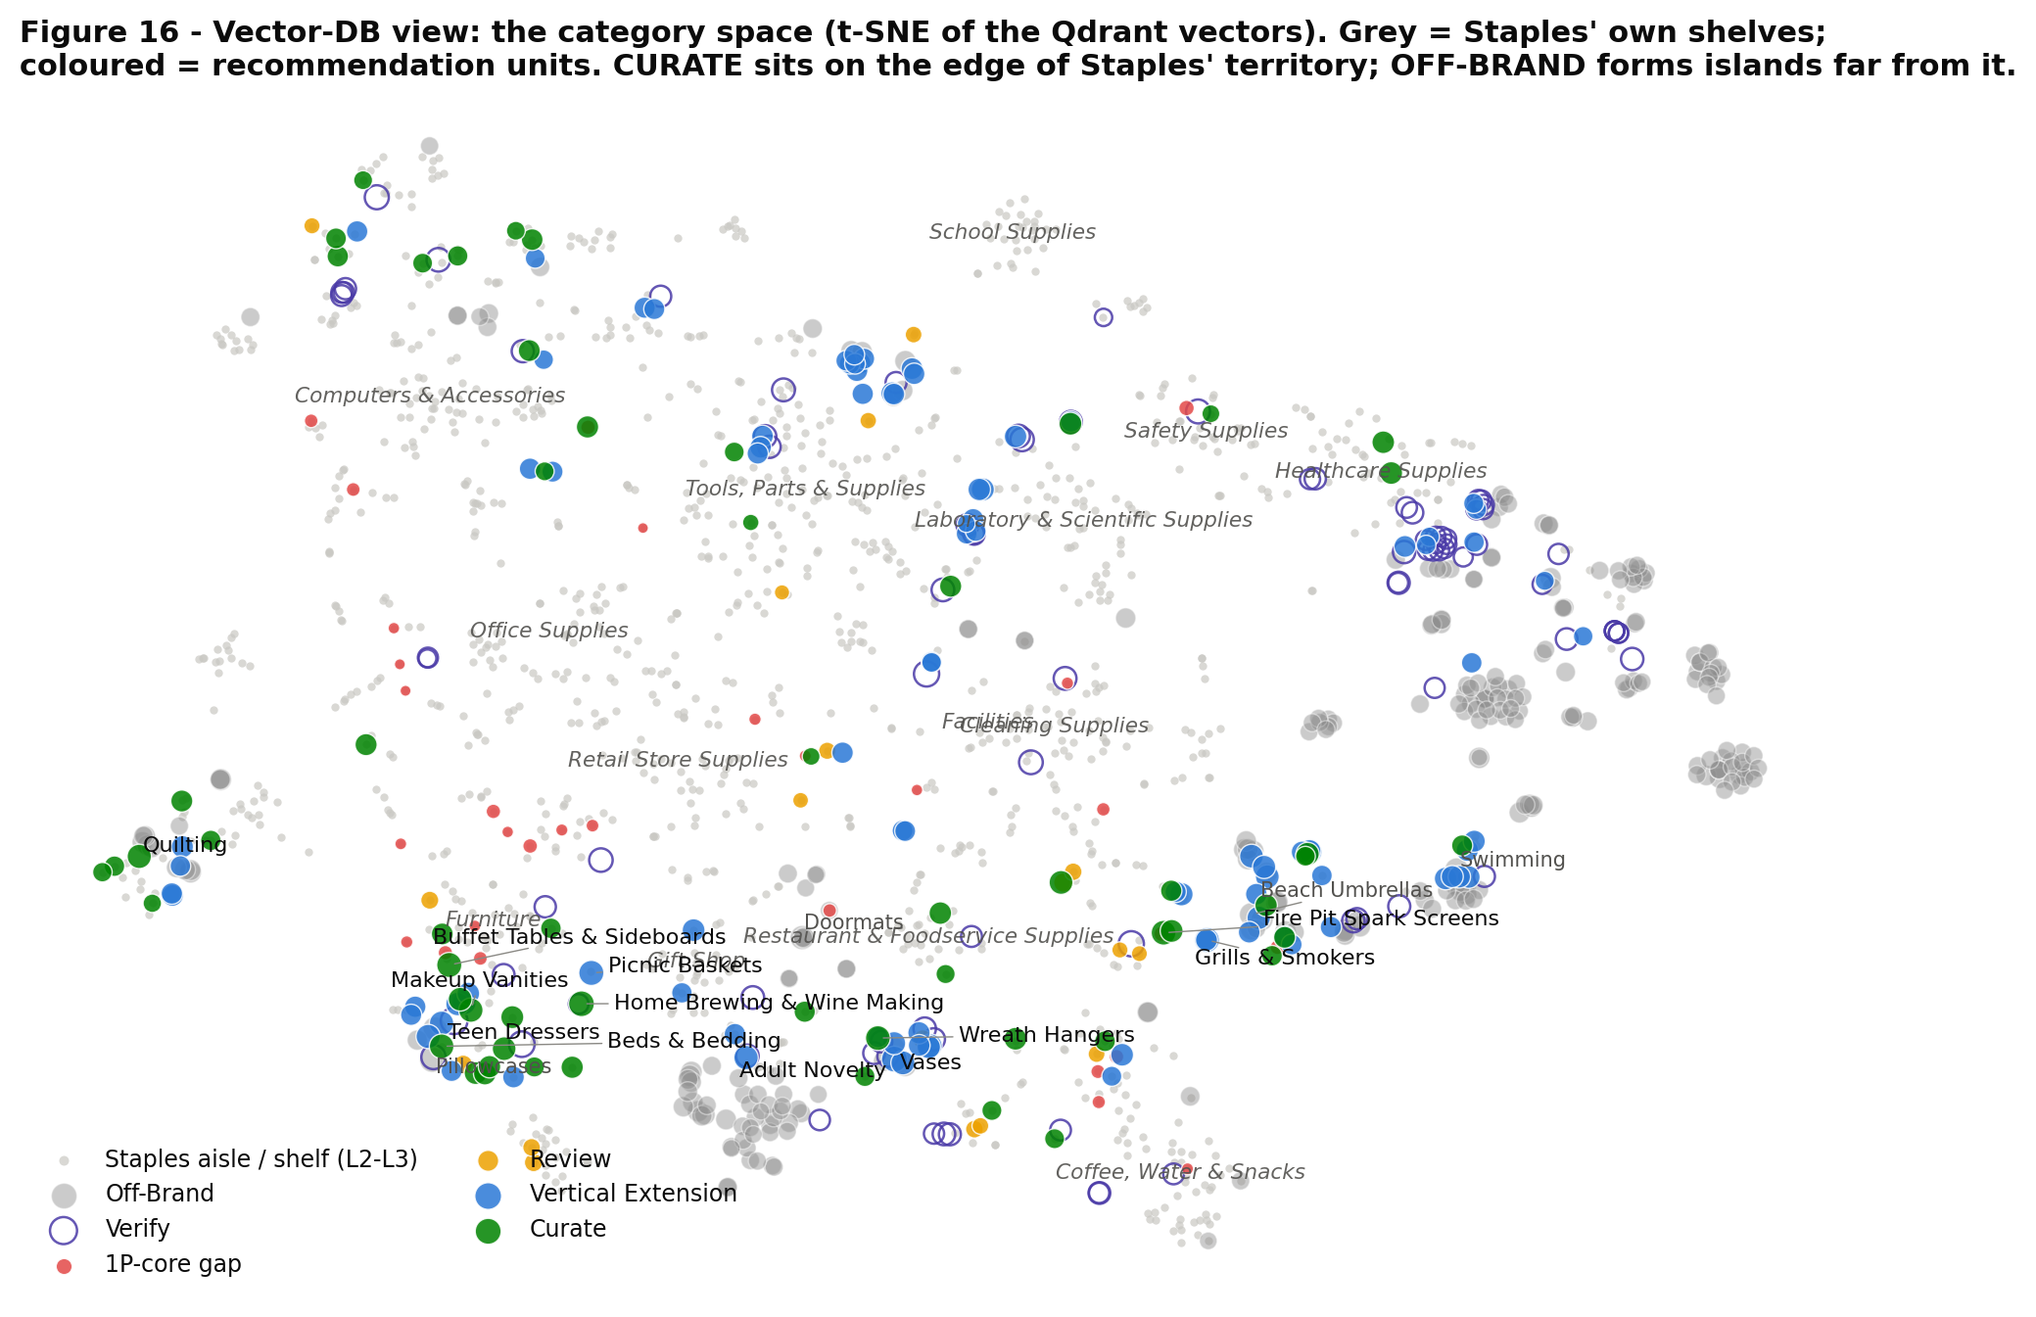
4 · HIGH-LEVEL RECOMMENDATIONS
Vector-DB view: CURATE sits at the edge of Staples' territory
Each dot is a category vector from the Qdrant collections, projected to 2-D (t-SNE)
Grey: Staples' own aisles and shelves. Colour: recommendation zone
CURATE and VERTICAL EXTENSION hug Staples' furniture, décor and kitchen clusters; OFF-BRAND forms separate islands (garden, sports, crafts)
Source: method_v_vector.py + run_framework.py → figures/fig16_vector_map.png

Slide 14
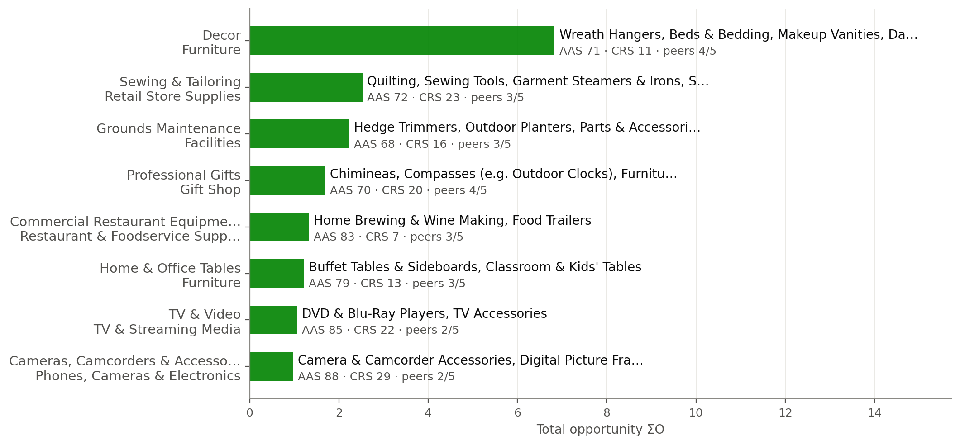
5 · RECOMMENDATIONS BY ZONE
Open these aisles to curated marketplace sellers now
CURATE
24 Staples aisles · 48 sub-categories with 2+ competitor evidence
What it means for Staples
Furniture › Décor is the flagship: bedding (West Elm 4x, Wayfair 10x deeper), bath & shower (8 items at Staples vs 144 at West Elm), candles, shower curtains, décor accents, plus new shelves (vanities, daybeds, wreath hangers)
Sewing & Tailoring: quilting, sewing machines, garment steamers (Amazon, Office Depot, Walmart)
Grounds & outdoor living: planters, hedge trimmers, patio shelf ('Compasses': rename it)
Home & office tables, commercial restaurant equipment, camera & TV accessories
Source: figures/slides/slide_zone_curate.png (deck version of fig08_zone_curate.png) · sheets CURATE, Aisle_Recommendations

Slide 15
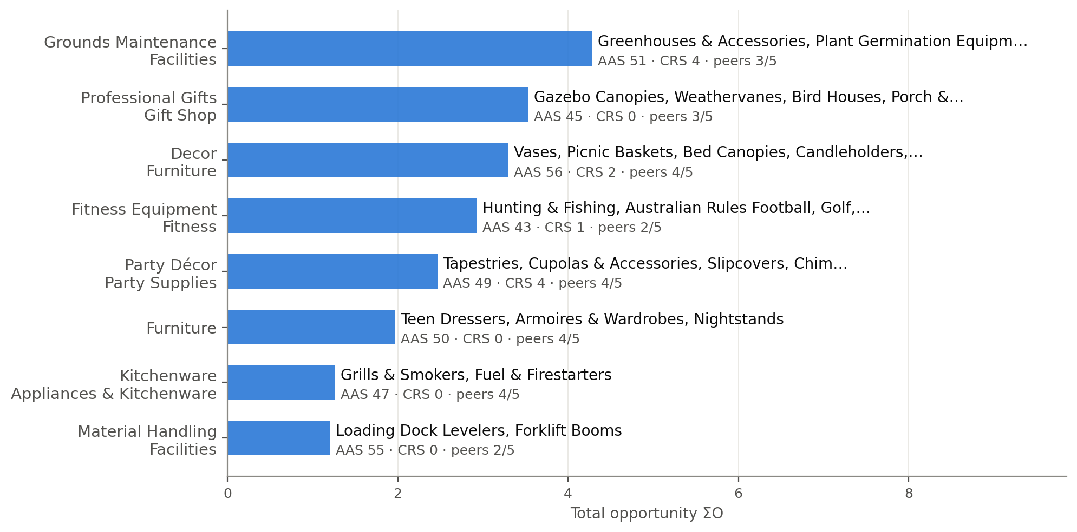
5 · RECOMMENDATIONS BY ZONE
Phase 2: enter through a vertical Staples already serves
VERTICAL EXTENSION
23 Staples aisles · 53 sub-categories with 2+ competitor evidence
What it means for Staples
Garden & grounds: greenhouses, germination, tillers; outdoor structures (gazebos, railings, shutters) – via facilities and hospitality buyers
Bedroom / dorm furniture: armoires, teen dressers, nightstands – via student living
Vases, picnic baskets, candleholders, curtains, slipcovers: the next wave after Décor opens
Fitness & sports sit at the low end of the zone: only via school or corporate wellness
Source: figures/slides/slide_zone_vertical_extension.png (deck version of fig09_zone_vertical_extension.png) · sheets VERTICAL_EXTENSION, Aisle_Recommendations

Slide 16
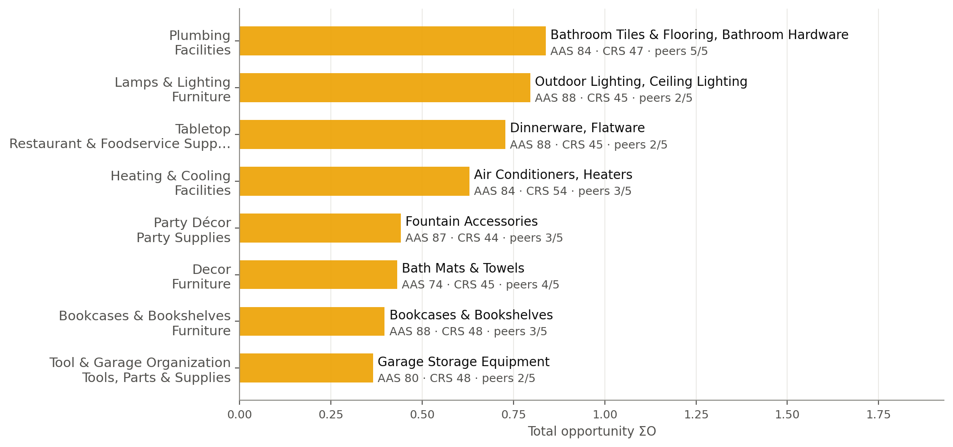
5 · RECOMMENDATIONS BY ZONE
Merchant decisions: real gaps next to a 1P line
REVIEW
14 Staples aisles · 18 sub-categories with 2+ competitor evidence
What it means for Staples
Lighting: ceiling and outdoor lighting deep at Wayfair/West Elm, but next to desk and facilities lighting
Tabletop & bath textiles: split home vs foodservice
Bathroom tiles & flooring: carried by all five competitors
Heaters, air conditioners, bookcases, microwaves, TV stands: decide on margin
Source: figures/slides/slide_zone_review.png (deck version of fig10_zone_review.png) · sheets REVIEW, Aisle_Recommendations

Slide 17
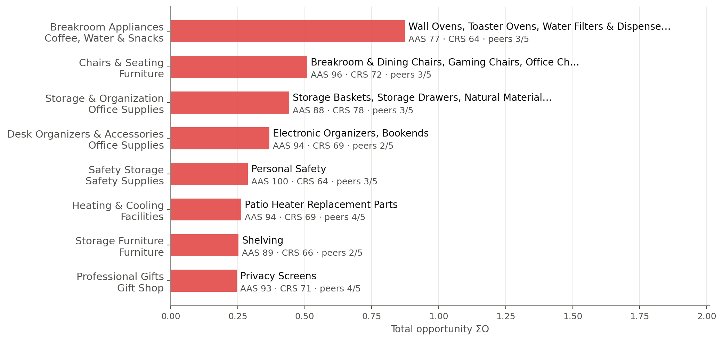
5 · RECOMMENDATIONS BY ZONE
Competitors are deeper in Staples' core – fix it in 1P
1P-CORE GAP
22 Staples aisles · 30 sub-categories with 2+ competitor evidence
What it means for Staples
Office chairs (Office Depot 5.7x, Wayfair 5.8x Staples' relative depth), gaming and breakroom chairs, chair mats, partitions
Breakroom appliances: blenders, toaster ovens, water filters (Office Depot 2–7x)
Consumables: binders, notebooks, markers, coffee, trash bags
A marketplace here would compete with Staples' own shelf
Source: figures/slides/slide_zone_1pcore_gap.png (deck version of fig11_zone_1pcore_gap.png) · sheets 1PCORE_GAP, Aisle_Recommendations

Slide 18
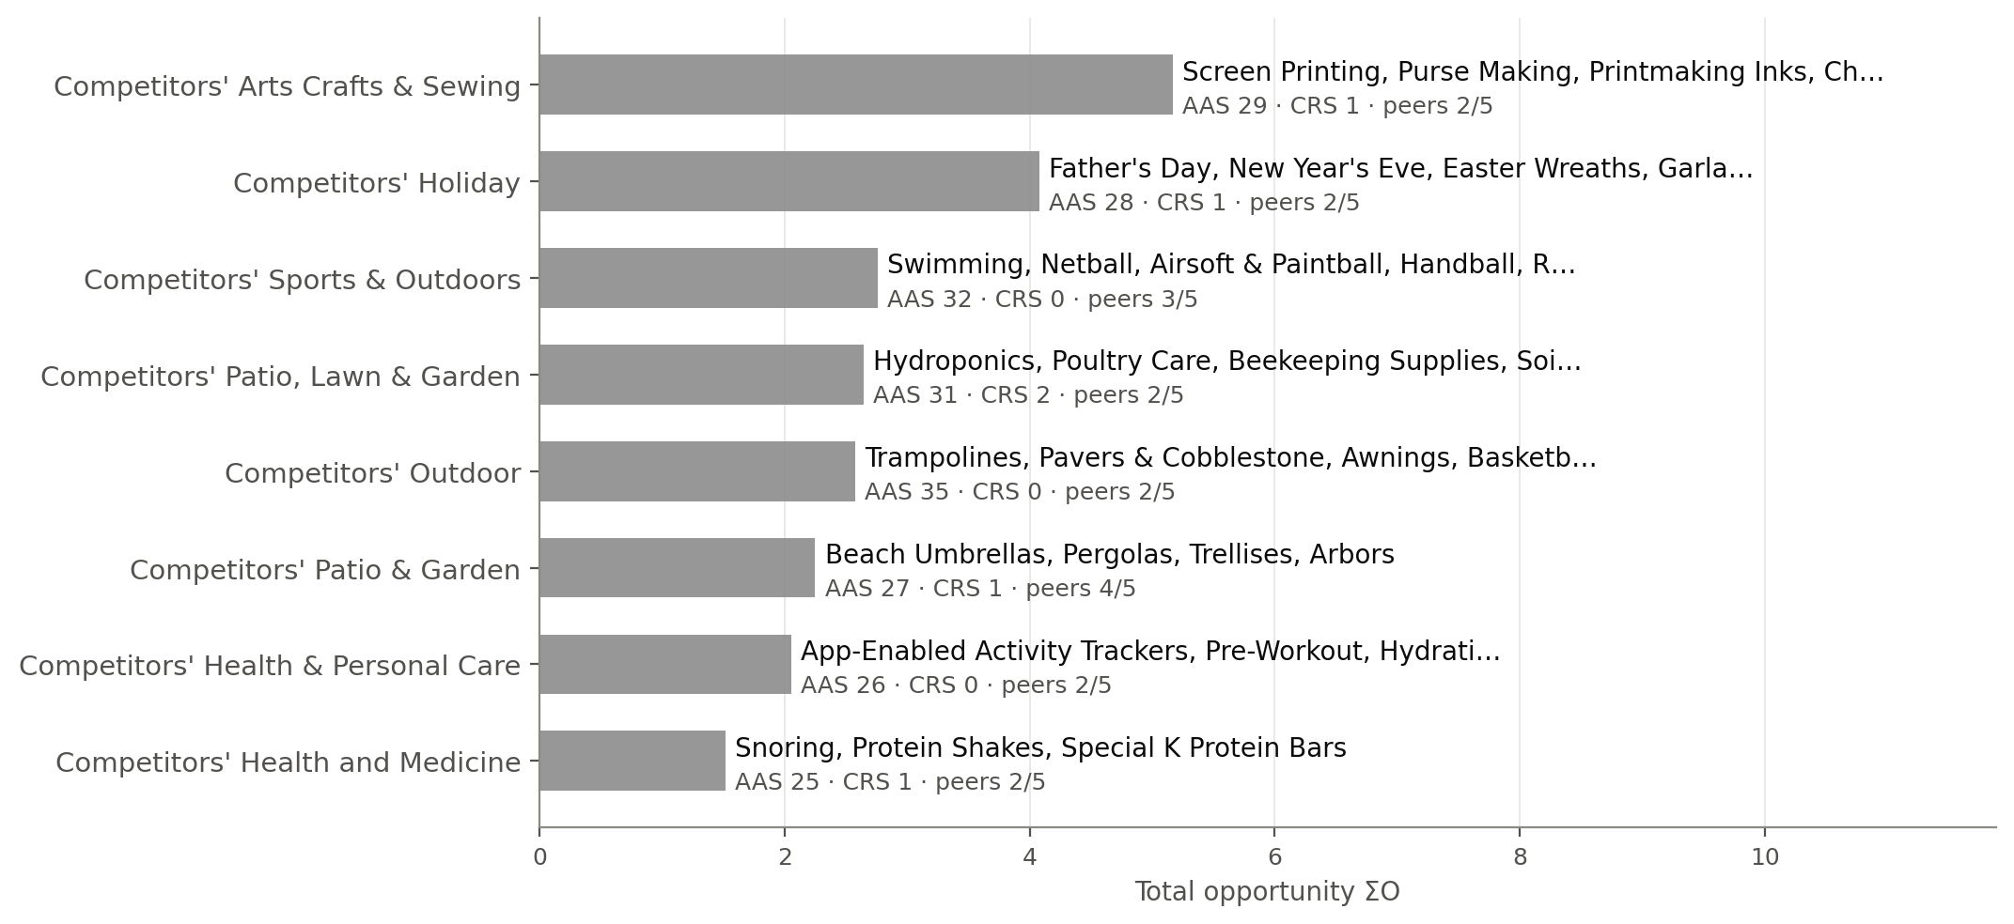
5 · RECOMMENDATIONS BY ZONE
Real gaps, wrong store: what we deliberately pass on
OFF-BRAND
16 competitor departments + 2 Staples aisles · 57 sub-categories with 2+ competitor evidence
What it means for Staples
Craft niches: screen printing, purse making, embroidery
Holiday-specific décor and seasonal novelties
Individual sports: swimming, handball, airsoft
Farm & garden supplies: hydroponics, beekeeping, poultry care, soils
Source: figures/slides/slide_zone_offbrand.png (deck version of fig12_zone_offbrand.png) · sheets OFFBRAND, Aisle_Recommendations

Slide 19
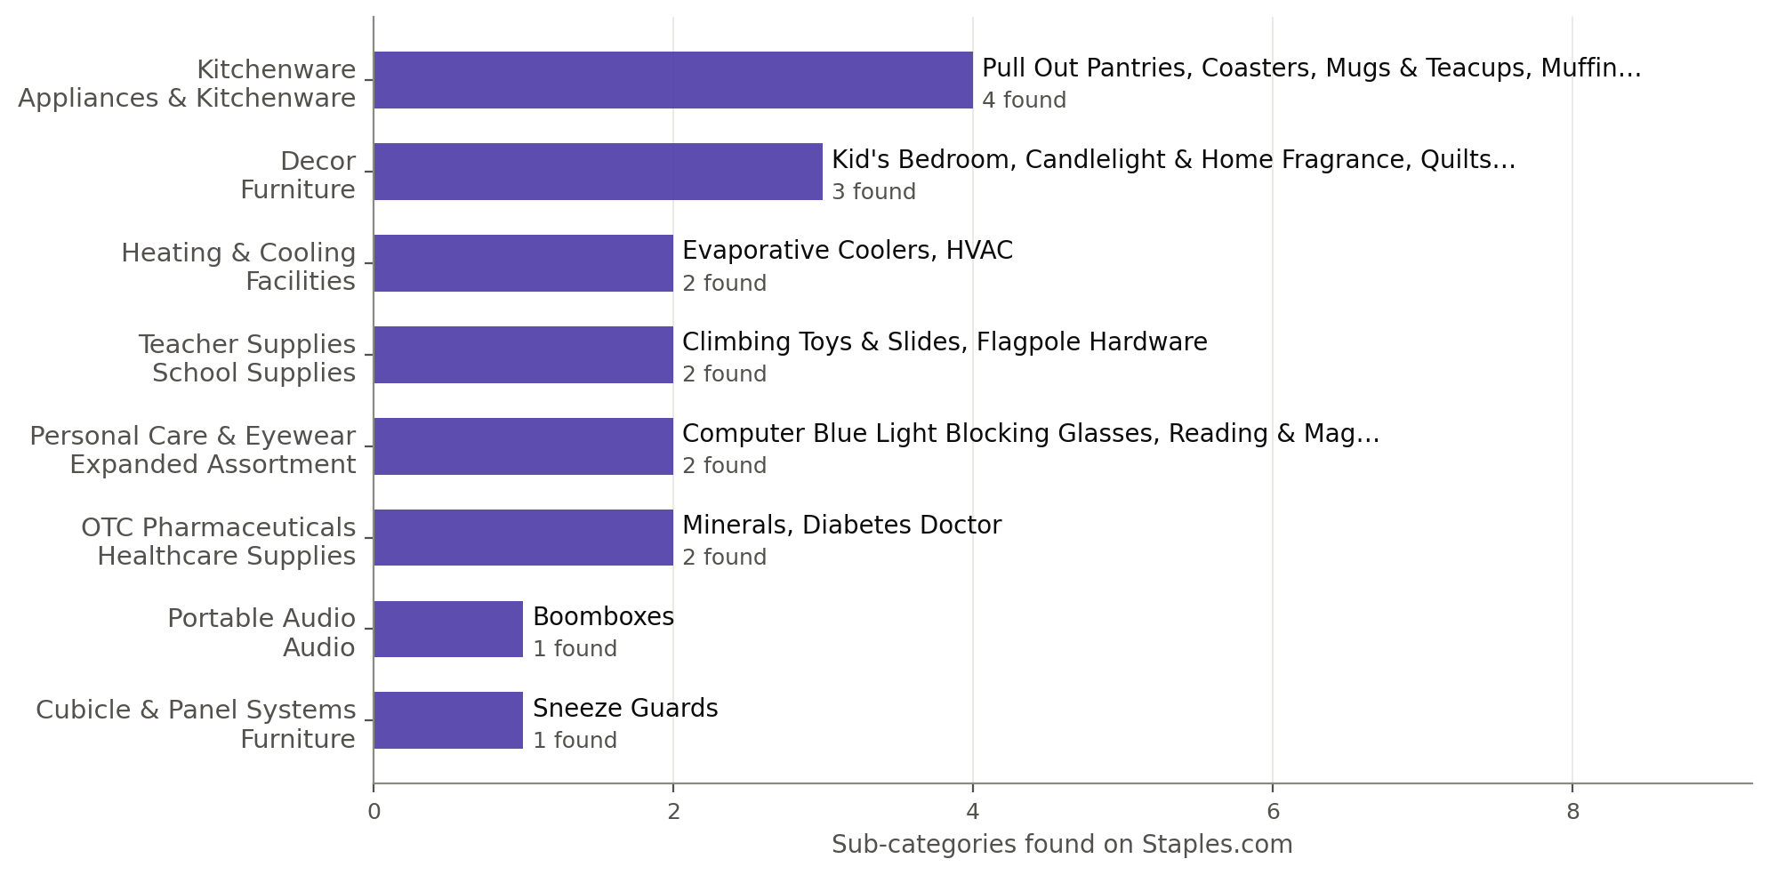
5 · RECOMMENDATIONS BY ZONE
Already sold, but hard to find: fix findability before buying assortment
VERIFY
22 Staples aisles · 31 sub-categories with 2+ competitor evidence
What it means for Staples
Rename or cross-list 'Compasses' (patio furniture)
Surface candles & home fragrance, evaporative coolers, pull-out pantries, quilts, sneeze guards under customers' words
Health brand pages (watch list) map to thin OTC shelves (Ear & Eye Drops: 4 items)
Checked, not guessed: 219 flagged gaps reviewed; 121 were already sold
Source: figures/slides/slide_zone_verify.png (deck version of fig13_zone_verify.png) · sheets VERIFY, Aisle_Recommendations

Slide 20
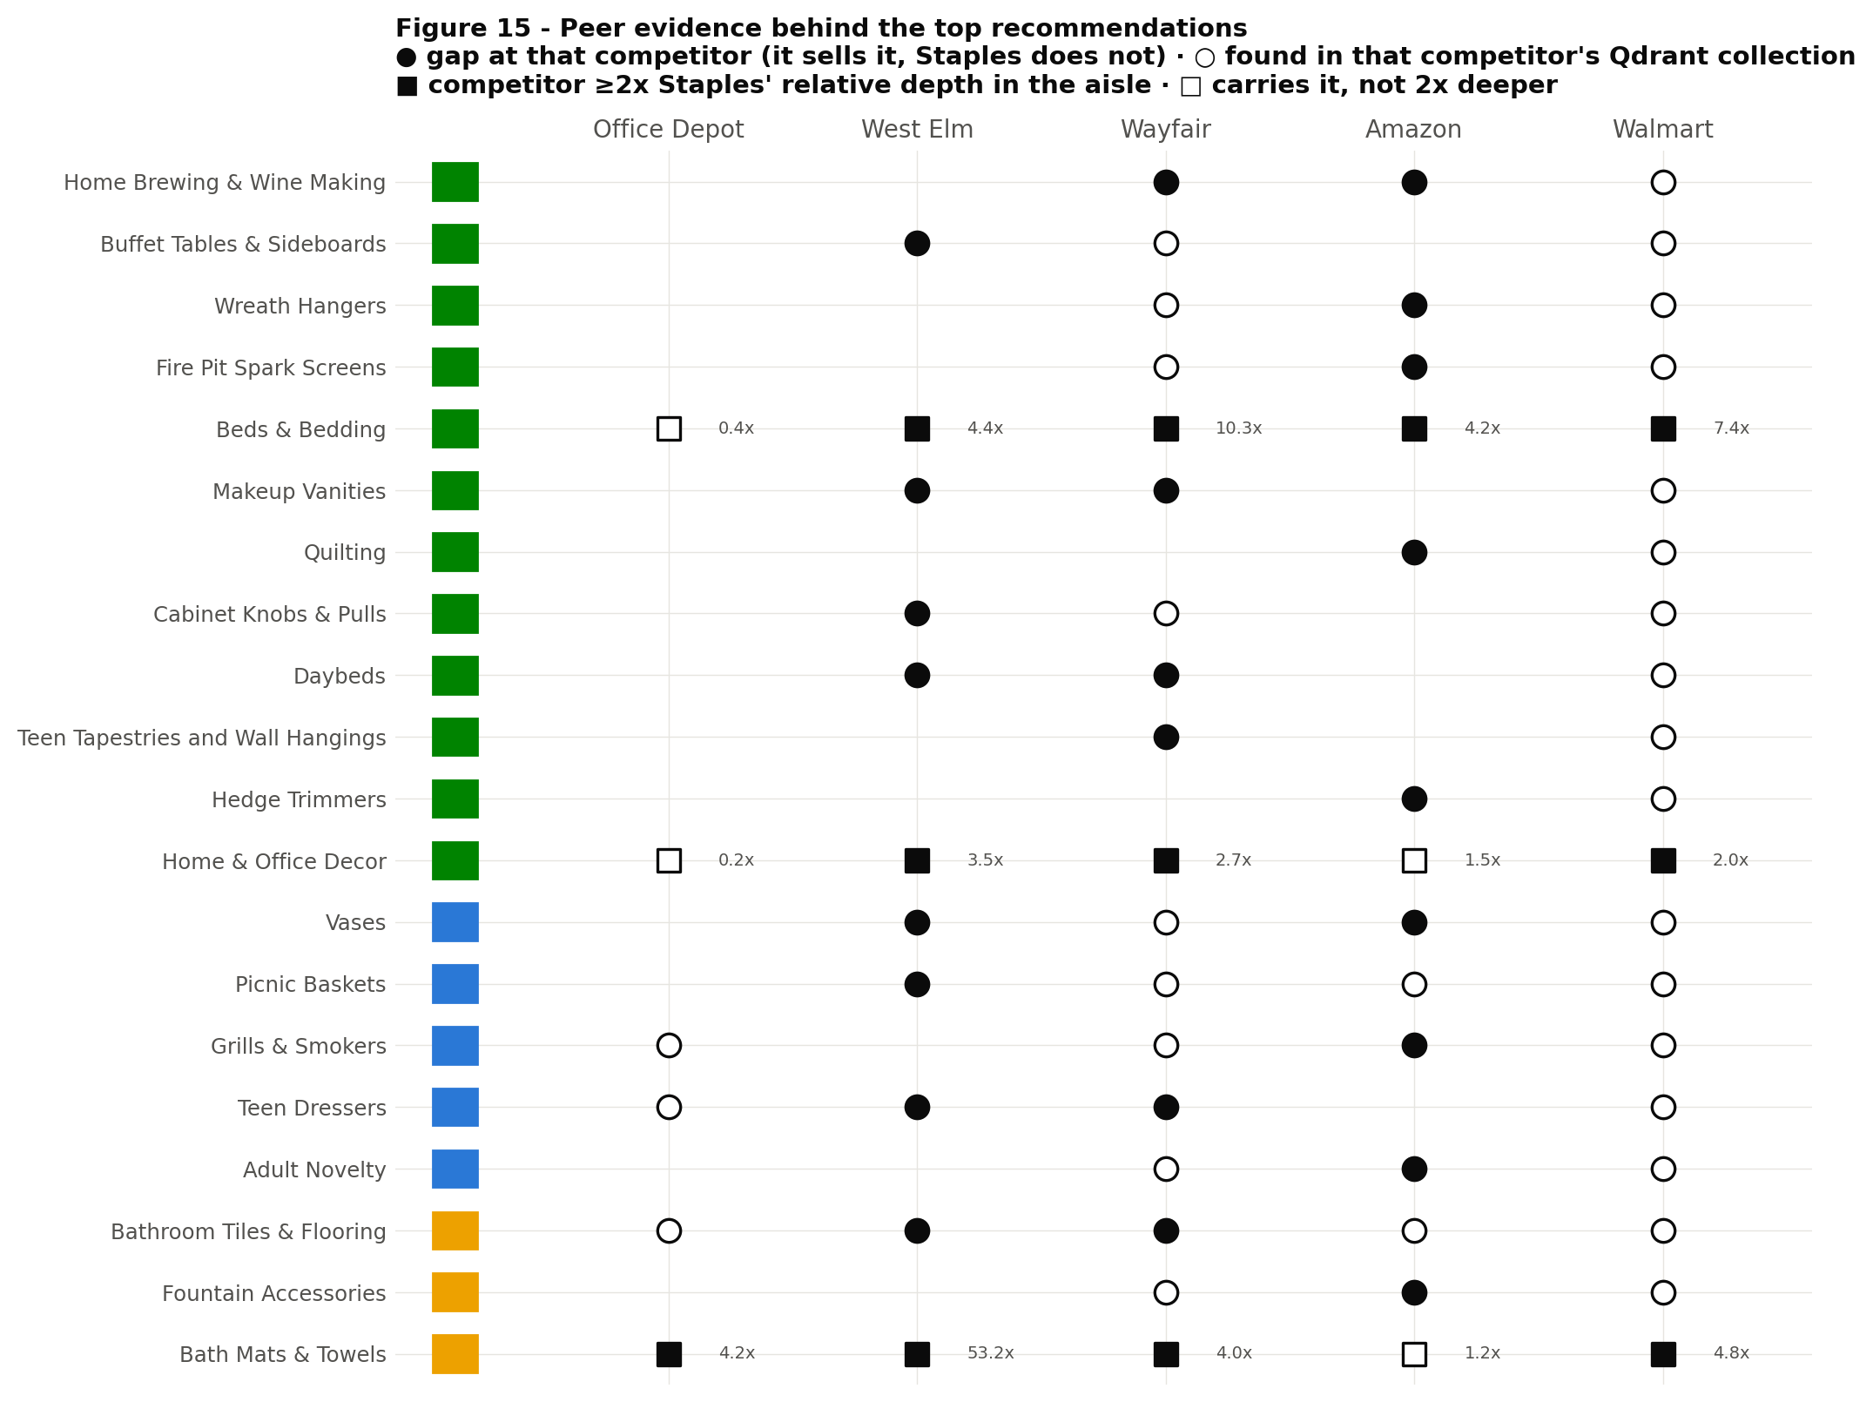
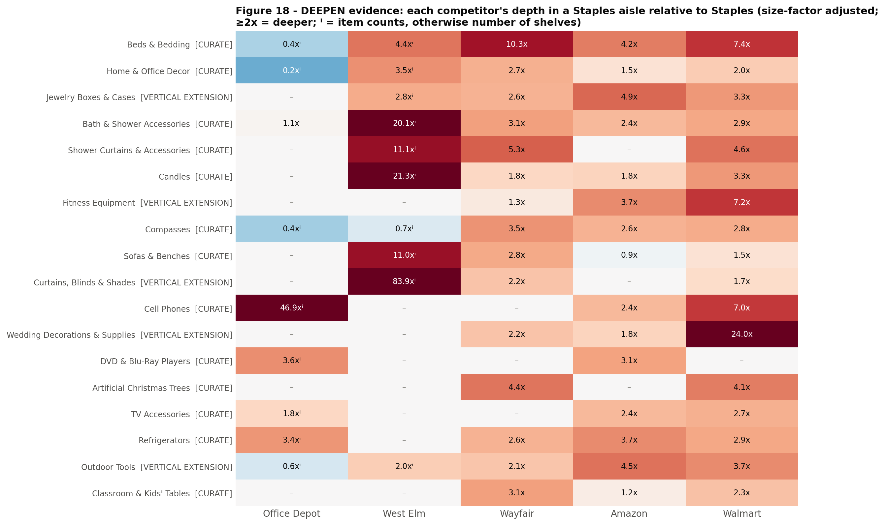
5 · RECOMMENDATIONS BY ZONE
CURATE evidence: several competitors, and multiples of Staples' depth
Source: figures/fig15_peer_consensus.png, fig18_deepen_evidence.png · sheets Concept_Members, Deepen_Evidence

Slide 21
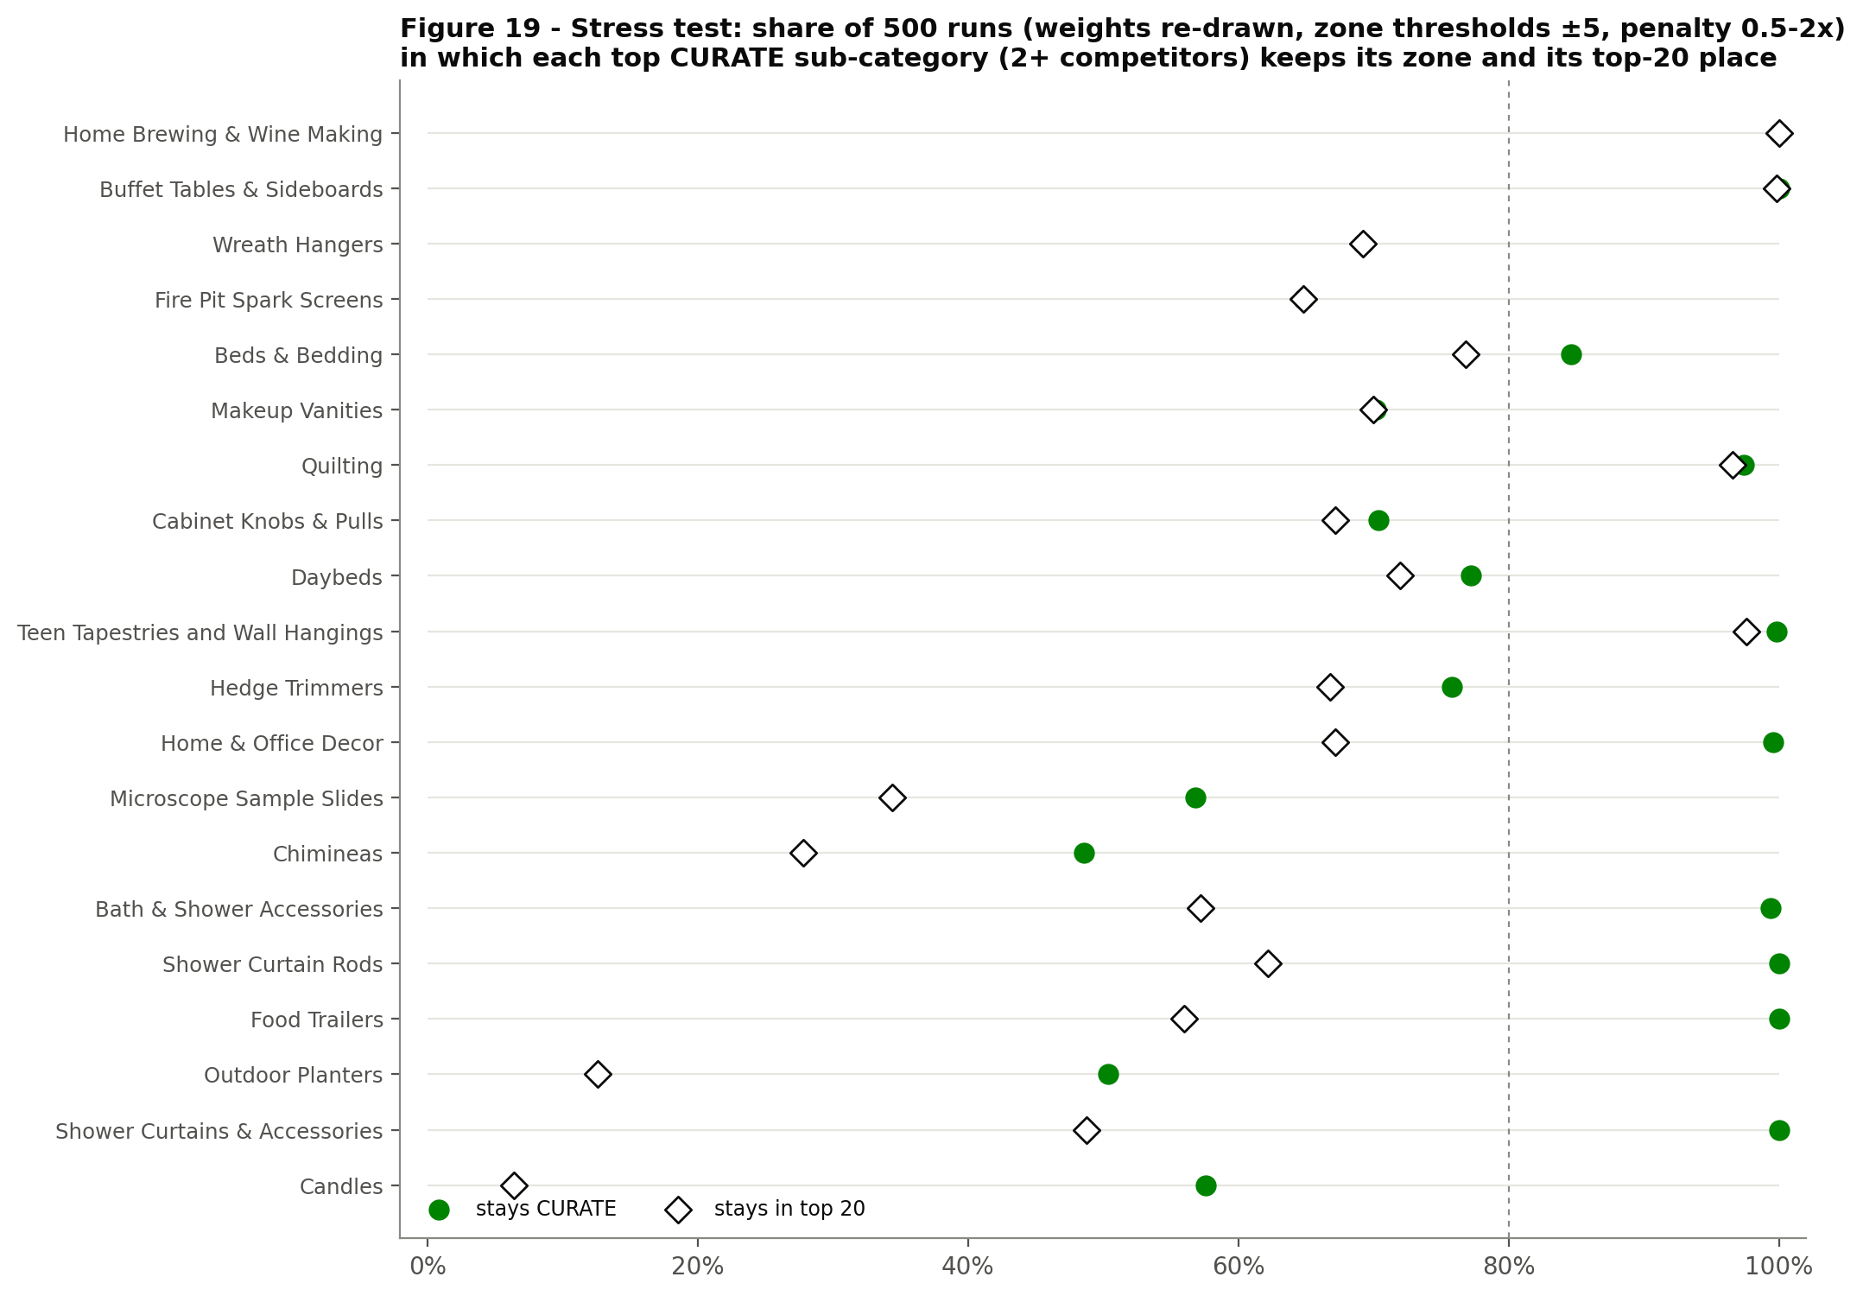
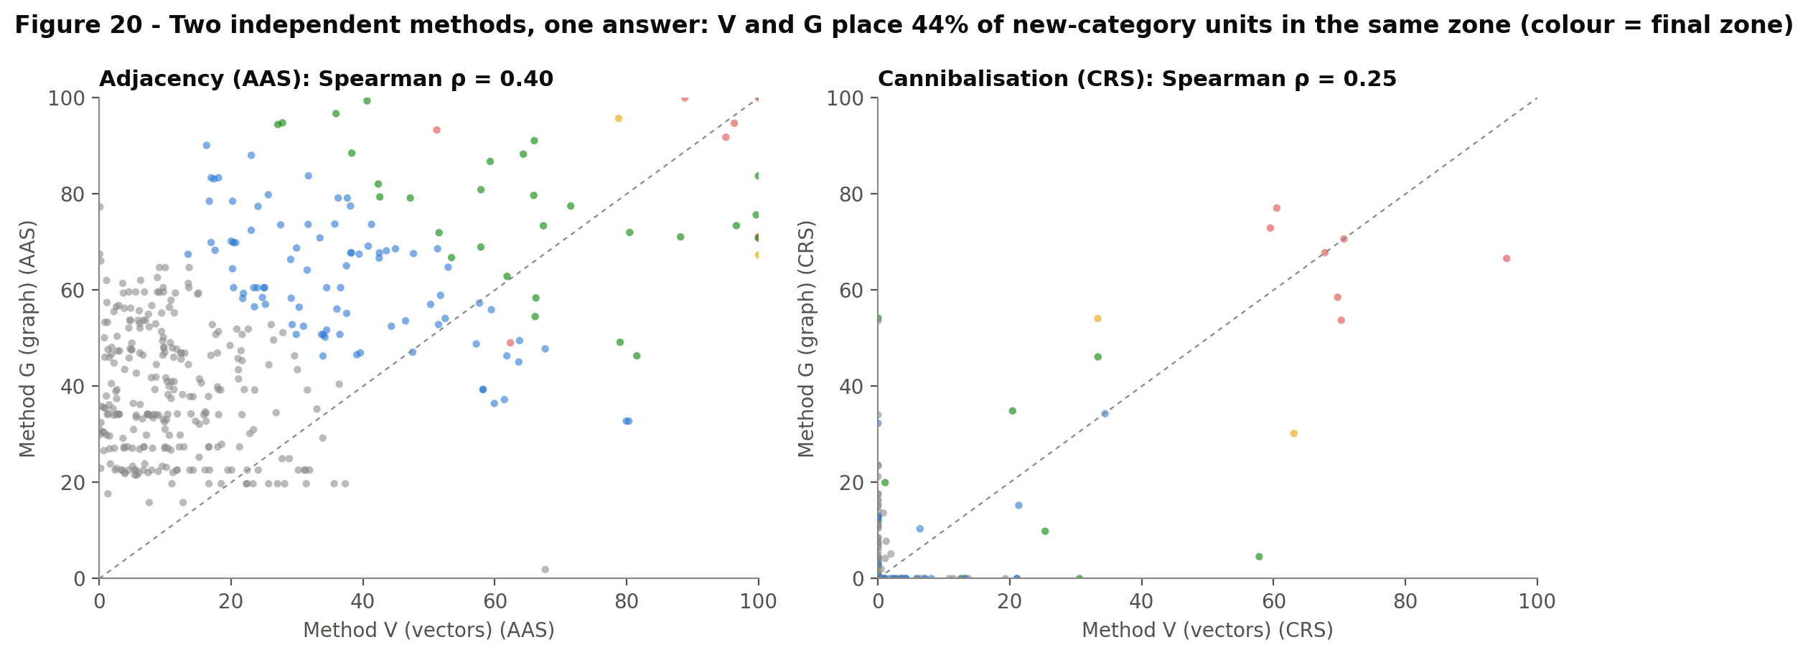
6 · CONFIDENCE
Zones are robust; the order inside a zone is a shortlist
10 of the top 20 CURATE sub-categories stay CURATE in ≥80% of 500 stress-test runs
Top-1 shelf match: Office Depot 84%; lifestyle and scale competitors 55%–70% – hence the verification loop
Not yet included: Staples sales and margin (CRS uses an editable 'coreness' assumption), demand signals, merchant-confirmed labels
Source: figures/fig19_sensitivity.png, fig20_method_agreement.png

Slide 22
NEXT STEPS
From recommendation to launch
1
Merchant session
2
Sales bands
3
Demand
Walk CURATE and REVIEW with category merchants; their verdicts flow back into the model as labels
Replace the coreness assumption with 1P revenue and margin by aisle
Add search volume for the top 40 sub-categories (optional term in O)
4
Archetype PoC
5
Findability fixes
6
Re-run quarterly
Décor (bedding, bath, candles), Sewing & Tailoring, outdoor living: SKU and attribute comparison
Rename 'Compasses', cross-list VERIFY items, add search synonyms – no new assortment needed
About 6 minutes end to end; a new competitor = 1 adapter + about 120 labelled rows

Slide 23
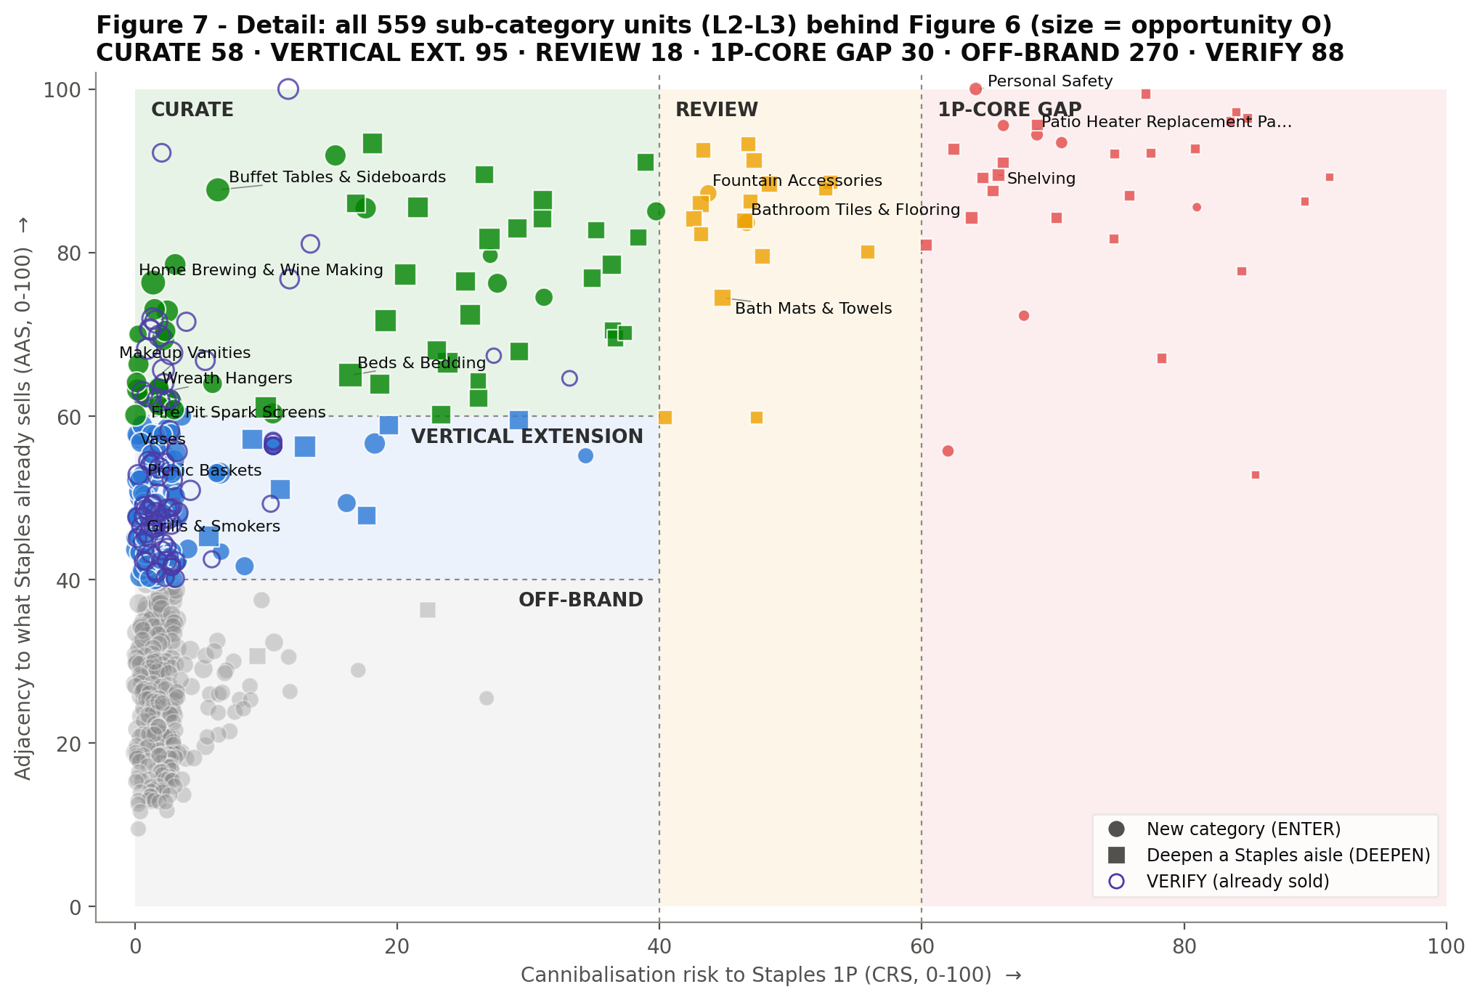
APPENDIX
Detail: every sub-category unit on the matrix
Source: figures/fig07_matrix_units.png · sheet All_Units

